Slide 1
Rural Municipality Crop Yield Prediction
Ethan Lam

Slide 2
Agenda
Introduction
The Problem
Solution

Slide 3
The problems
I want to find the best place in Saskatchewan to grow Barley
I want to know if my investment is good in terms of the ROI or I want to forecast the yields in a specific Rural Municipality of a crop

Slide 4
Data Collection and Preprocessing
Crop yield data:
Crop yields by Rural Municipality (RM) are produced annually from the Ministry of Saskatchewan Crop Report and Saskatchewan Crop Insurance Corporation
Data provided from 1938 to 2022.
Geospatial:
The shapefile from Government of Saskatchewan
First look at the data
Year | RM | Winter Wheat | Canola | Spring Wheat | Mustard | Durum | Sunflowers | Oats | Lentils | Peas | Barley | Fall Rye | Canary Seed | Spring Rye | Tame Hay | Flax | Chickpeas
1938 | 1 | NaN | NaN | 4 | NaN | NaN | NaN | 1 | NaN | NaN | 1 | NaN | NaN | NaN | NaN | 0 | NaN
1939 | 1 | NaN | NaN | 9 | NaN | NaN | NaN | 16 | NaN | NaN | 16 | NaN | NaN | NaN | NaN | 0 | NaN
1940 | 1 | NaN | NaN | 12 | NaN | NaN | NaN | 23 | NaN | NaN | 19 | NaN | NaN | NaN | NaN | 8 | NaN
1941 | 1 | NaN | NaN | 18 | NaN | NaN | NaN | 32 | NaN | NaN | 28 | NaN | NaN | NaN | NaN | 5 | NaN
1942 | 1 | NaN | NaN | 20 | NaN | NaN | NaN | 35 | NaN | NaN | 28 | 14 | NaN | NaN | NaN | 5 | NaN

Slide 5
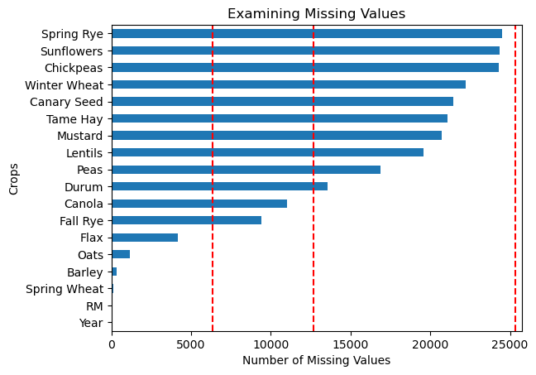
Data Quality Check
Check for NULL/Missing values
Many missing values
Check for duplicate
No duplicate was found

Slide 6
EXPLORATORY DATA ANALYSIS
Understand that there are 25312 entries in the dataset
There are 18 columns in the dataset
There are 299 RMs

Slide 7
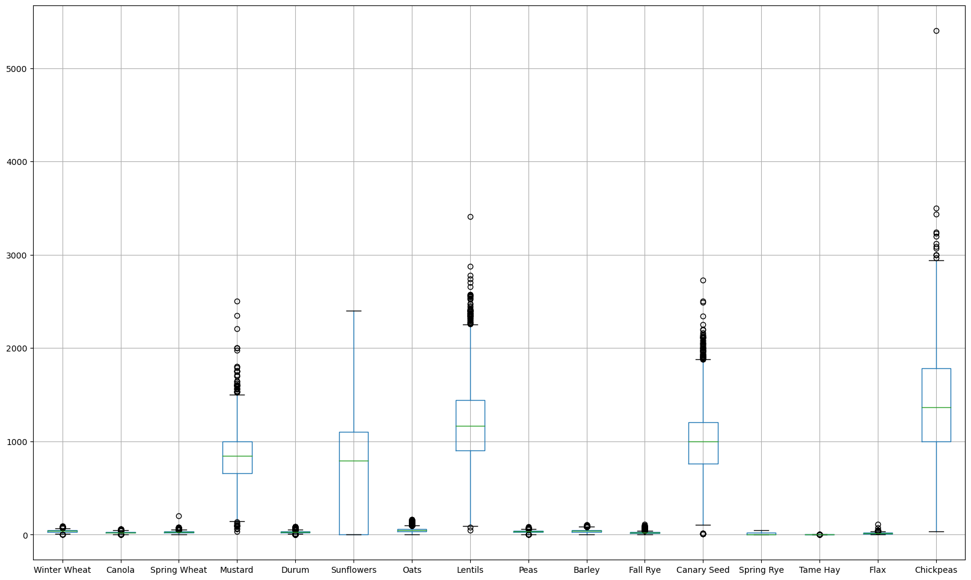
Check Outliers
There are many outliers in the data of Mustard, Lentils, Canary Seeds, and Chickpeas

Slide 8
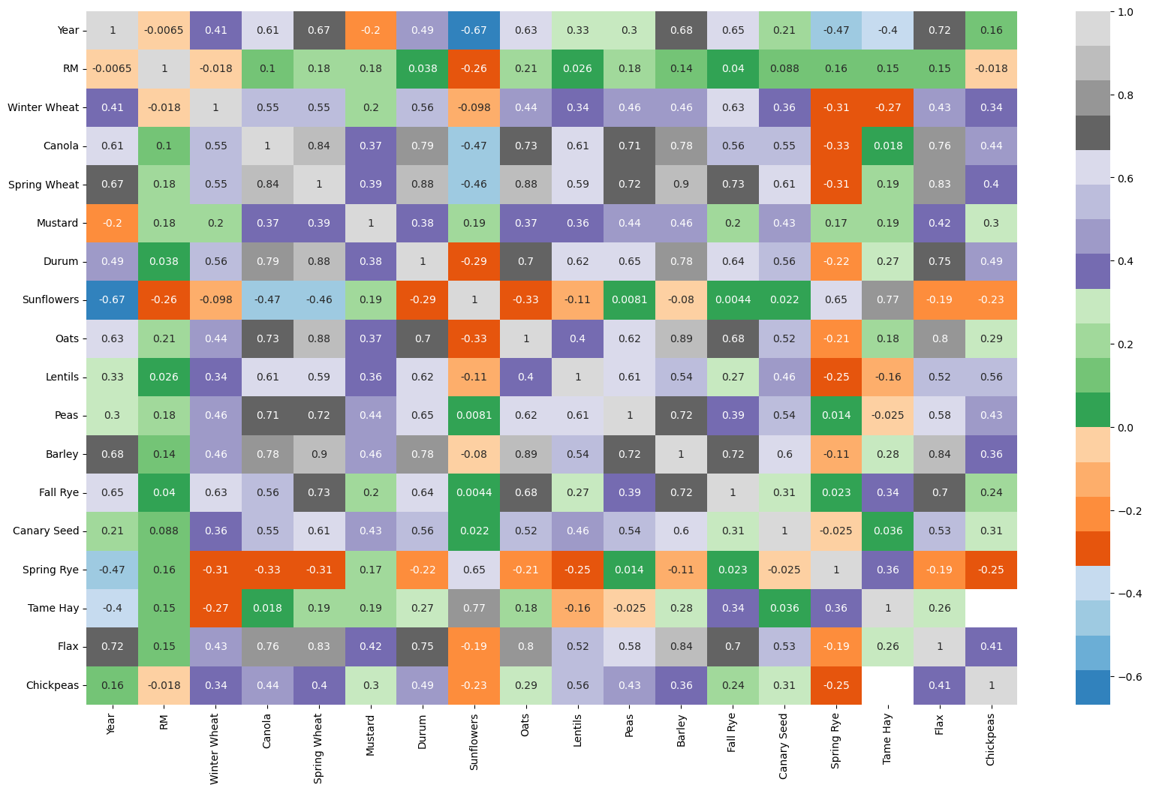
Correlation Matrix

Slide 9
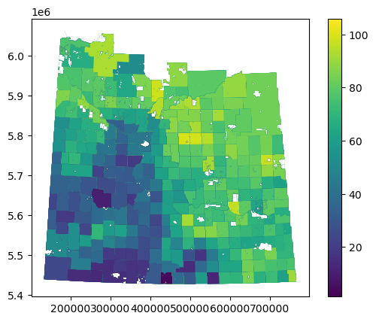
GIS Analysis
The place has the highest average Barley yield in the last 10 year is RM: 369

Slide 10
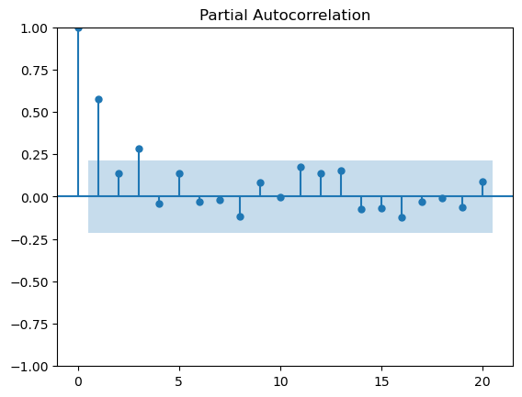
Time Series: Partial Autocorrelation (Spring Wheat)
- When analyzing the plot, we can see that the first lag has a very strong correlation to our future value.
- Lag 5 is the last lag the clearly goes above the green threshold line. As such, we now know to use 5 lags to create our auto regression model

Slide 11
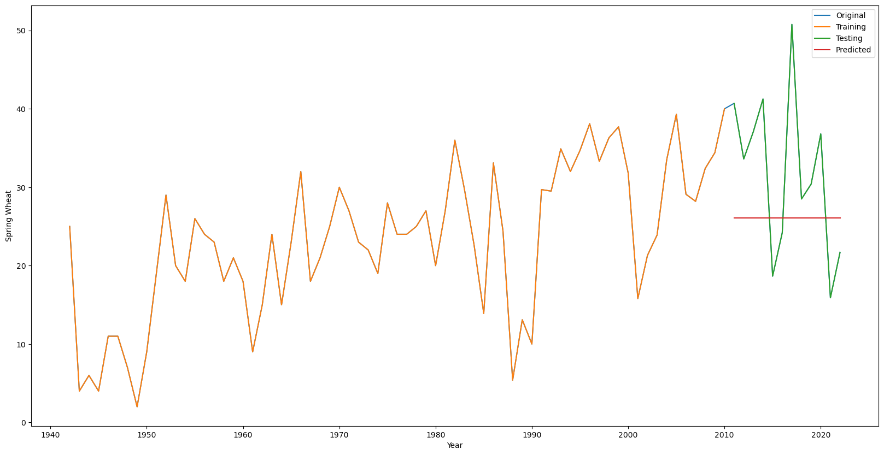
Time Series (Autoregressive model)

Slide 12
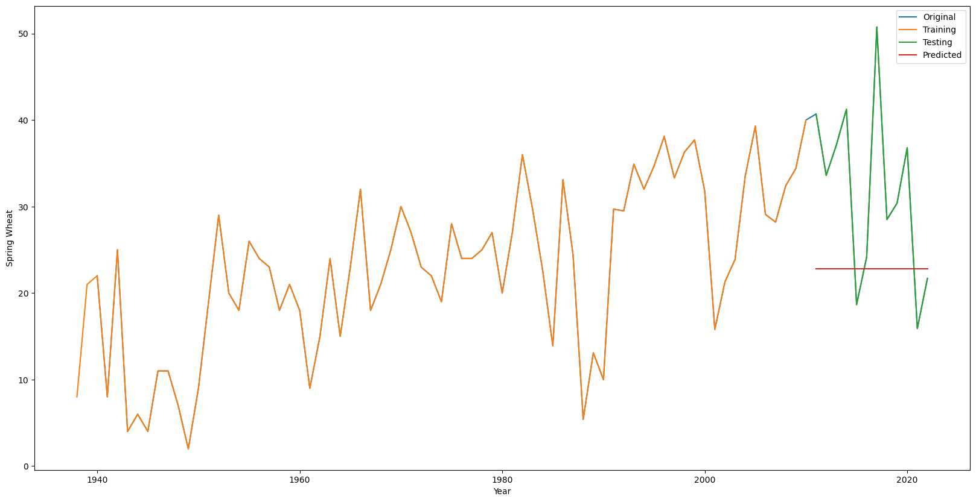
Time Series: ARIMA

Slide 13
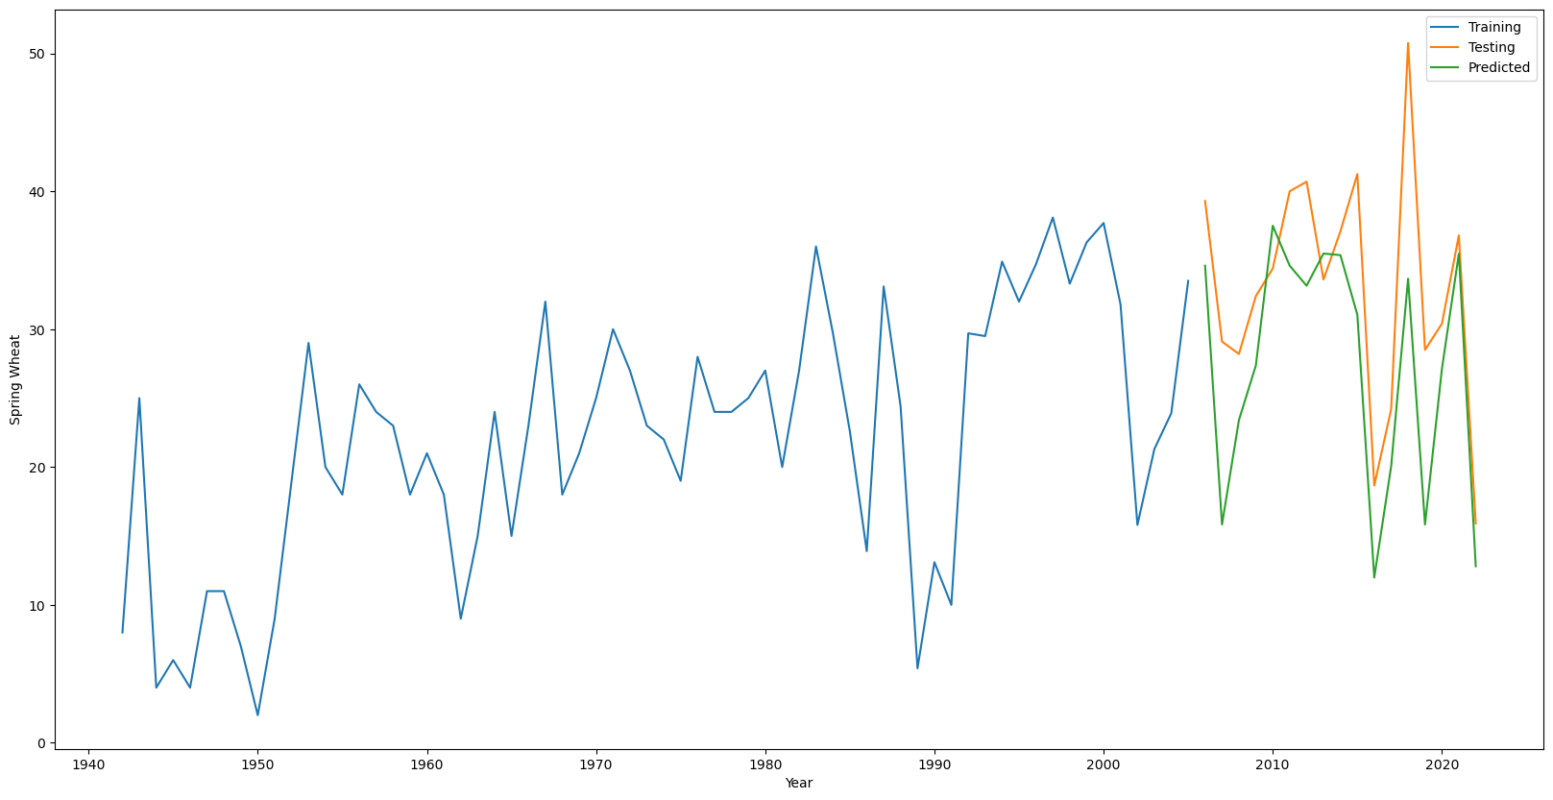
Time Series: XGBoost

Slide 14
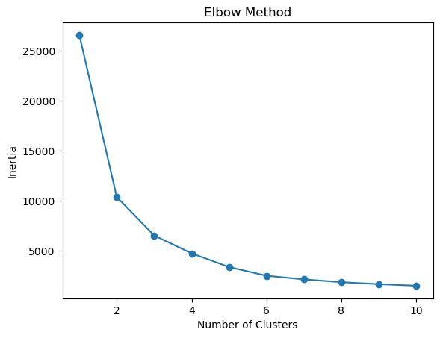
Unsupervised Learning – k number
The image show that the k=5 is not a bad choice

Slide 15
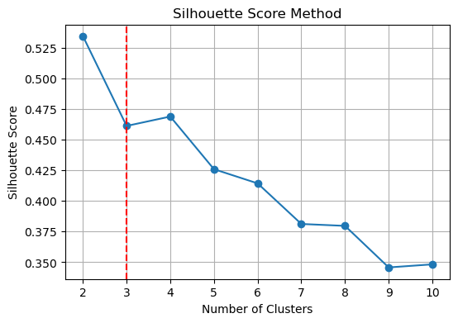
Silhouette Analysis
Used to determine the degree of separation between clusters

Slide 16
Thank you

